Slide 1
SemaphoreS priority inveRsion
By :
Karem Mohamed Abd Elmonaem
Supervisor:
Eng : Engy

Slide 2
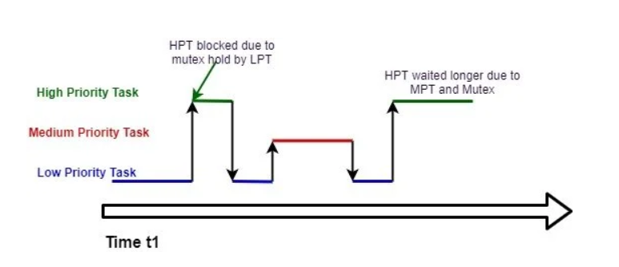
Priority Inversions
Priority inversion real-time systems and occurs mostly when you use a real-time kernel.
In Priority Inversion, higher priority task (H) ends up waiting for middle priority task (M).
❑ H is sharing critical section with lower priority task (L).
❑ L is already in critical section.
❑ Effectively, H waiting for M results in inverted priority

Slide 3
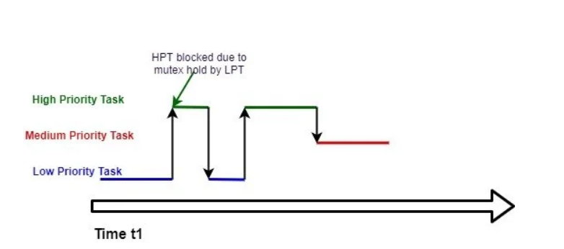
Priority Inheritance..
One of the solution for this problem is Priority Inheritance..
In Priority Inheritance, when L is in critical section, L inherits priority of H at the time when H starts pending for critical section. By doing so, M doesn’t interrupt L and H doesn’t wait for M to finish.
L goes back to its old priority when L comes out of critical section.
❑ Inheriting of priority is done temporarily .

Slide 4
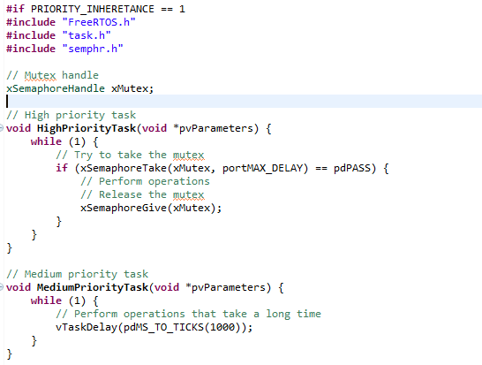
Priority Inheritance..

Slide 5
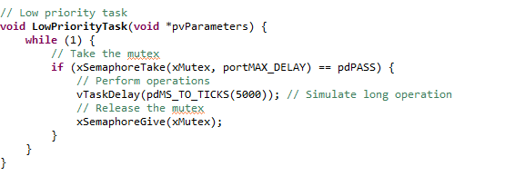
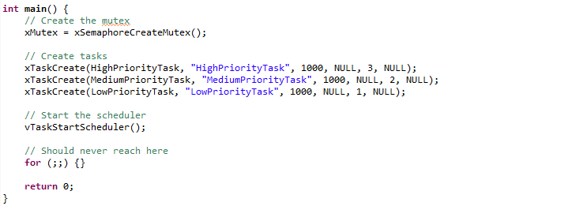
Priority Inheritance..

Slide 6
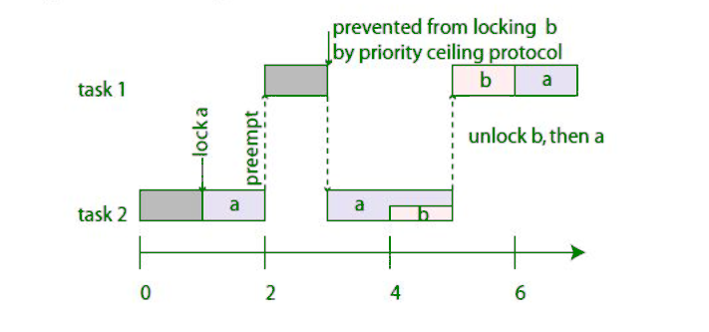
Priority ceiling..
Priority ceiling protocol is another method to solve the priority inversion problem. It works by preventing a lower-priority task from accessing a resource if doing so could block a higher-priority task.
In FreeRTOS, we don't have explicit support for priority ceiling. However, you can simulate priority ceiling by using mutexes with carefully managed priorities.

Slide 7
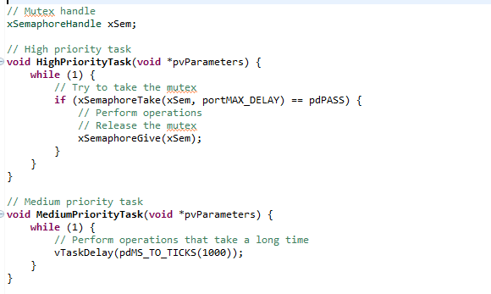
Priority ceiling..

Slide 8
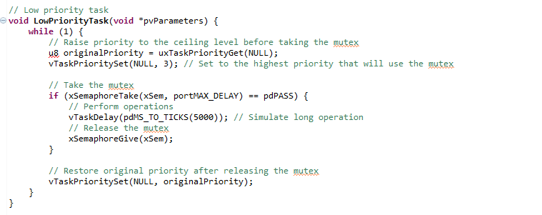
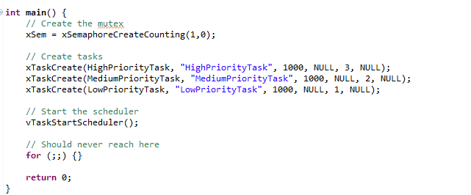
Priority ceiling..

